Slide 1
House Sales Prediction
A multivariate regression model
Andrew Liu 100390239
Bruno Schwartz 100389514
Guilherme Machado 100373159
Manmeet Kaur 100389371
Oscar Jimenez 100385707

Slide 2
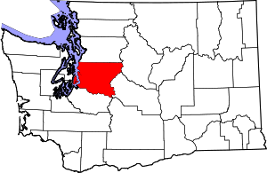
Data Source
Link: https://www.kaggle.com/code/himahima/house-sales-prediction/data?select=kc_house_data.csv
About:
2019 King County, Washington State,
USA Housing Price Data
21 Columns, 21614 Rows
Notes:
Gui

Slide 3
Dataset Description
Numerical
price
bedrooms
bathrooms
sqft_living
sqft_lot
floors
sqft_above
sqft_basement
yr_built
yr_renovated
zipcode
lat
long
sqft_living15
sqft_lot15
Notes:
Gui

Slide 4
Dataset Description
Categorical
waterfront
view
condition
grade
Notes:
Gui

Slide 5
Data Cleaning
No missing values found
No duplicates found
No unexpected values found
Notes:
Gui

Slide 6
Variable Selection
Dropped Columns: id, date
Converted the following variables to nominal data type:
Waterfront (0, 1)
View (0, 1, 2, 3, 4)
Condition (1, 2, 3, 4, 5)
Grade (1 to 13, integer)
Notes:
Andrew

Slide 7
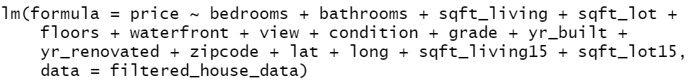

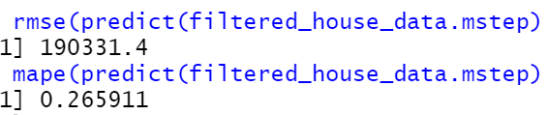
Stepwise Variable Selection: Results
Notes:
Andrew

Slide 8
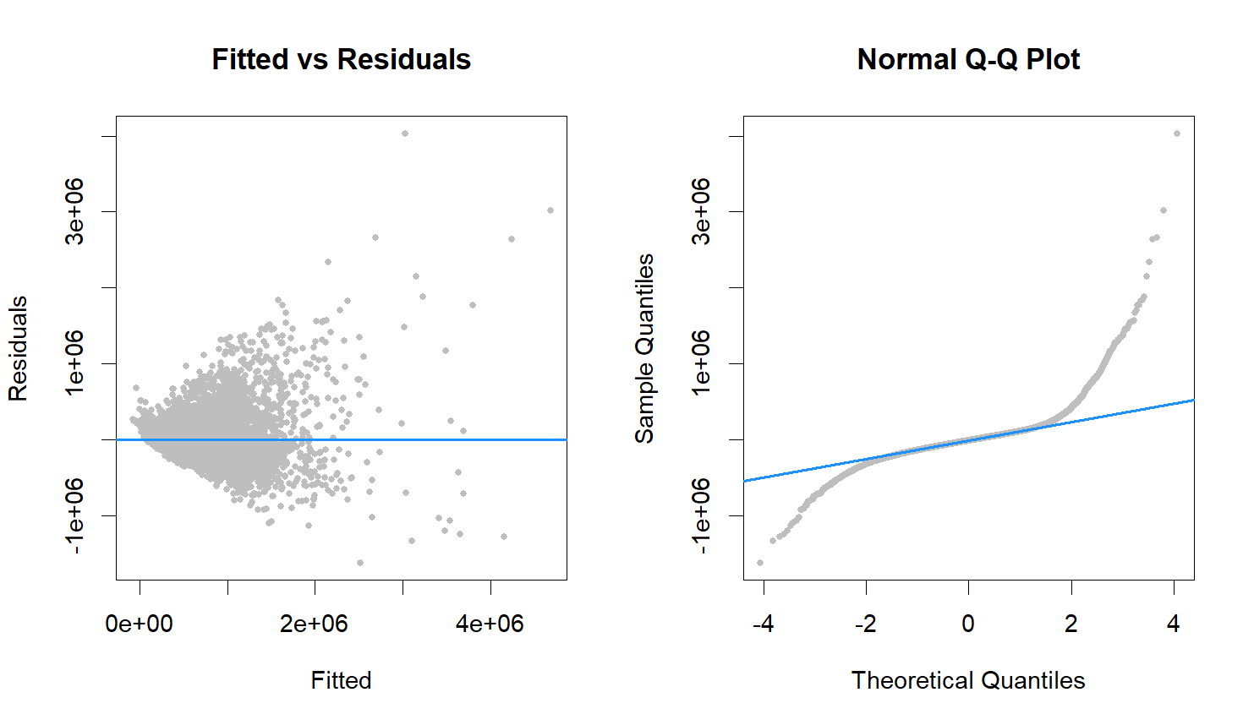
Residuals vs Prediction - initial model
Notes:
Andrew

Slide 9

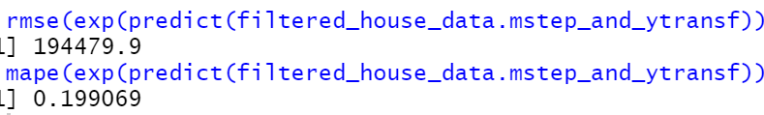
Fixing heteroscedasticity: response variable transformation
Notes:
Bruno

Slide 10
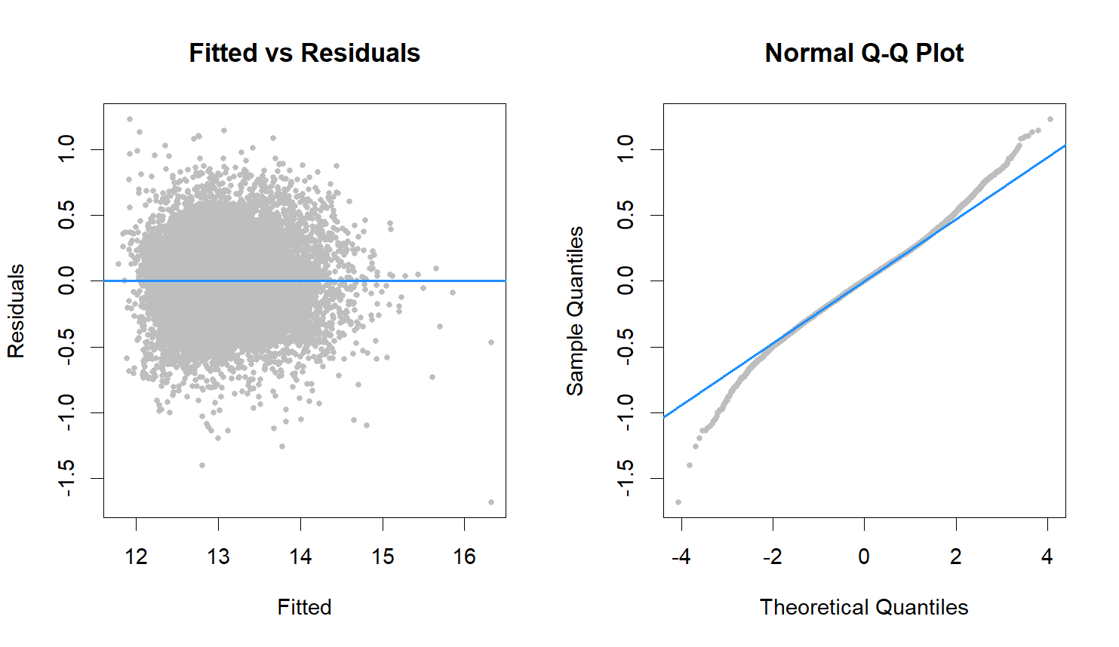
Residuals vs Prediction - Adjusted model
Notes:
Bruno

Slide 11
Residuals vs Prediction - Adjusted model
Notes:
Bruno

Slide 12
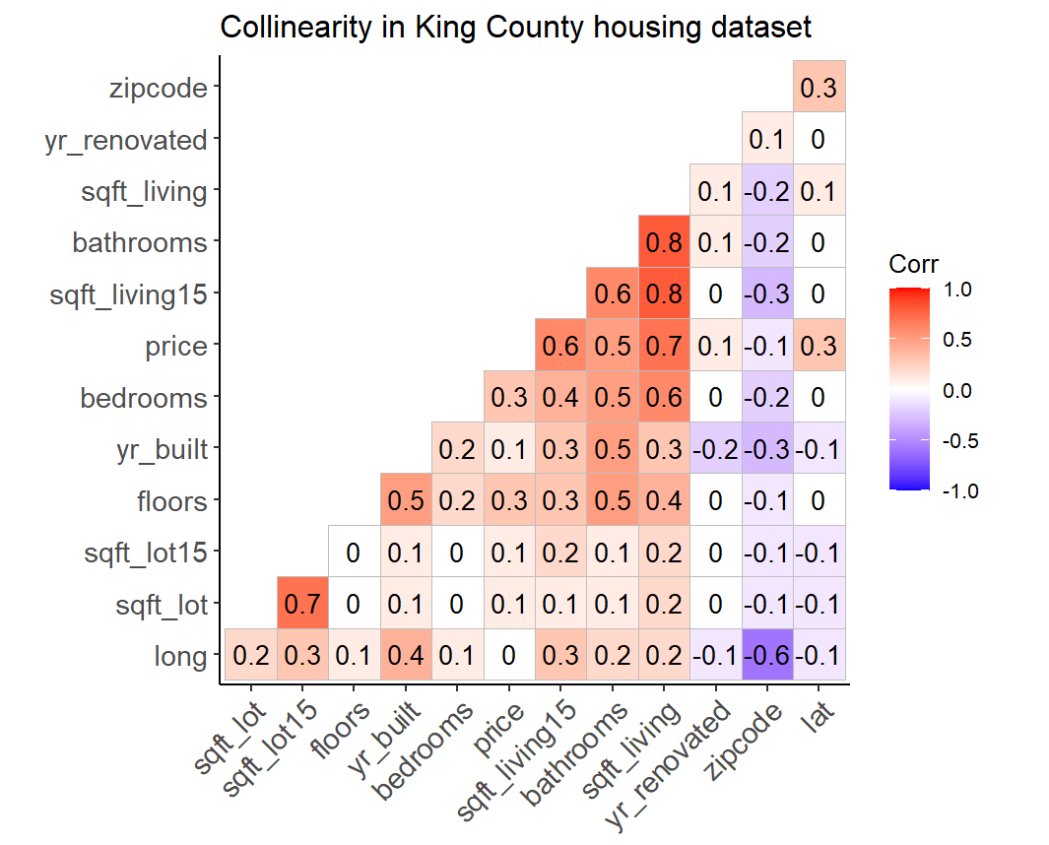
Correlation Matrix
Notes:
Bruno

Slide 13
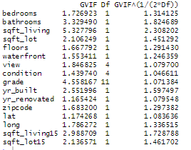
Variance Inflation Factor
Notes:
Bruno

Slide 14

Removal of influential points: Cook’s Distance
Bad Influential Points Influential Points
Notes:
Oscar

Slide 15
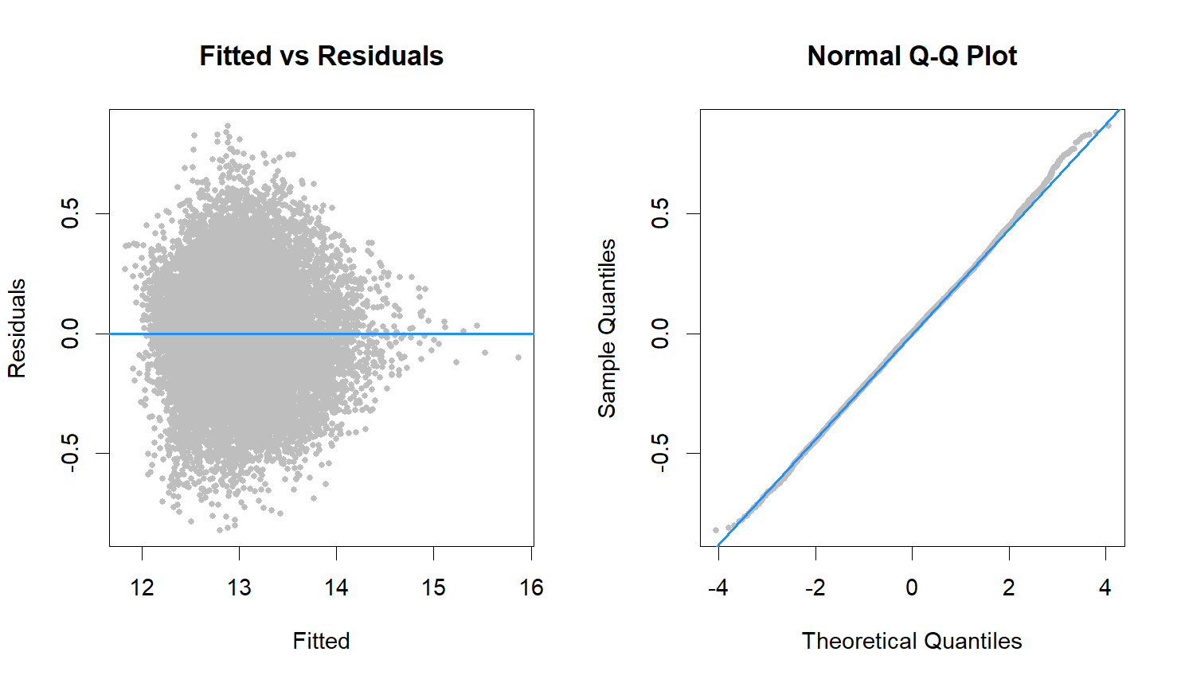
Residuals vs Prediction - Readjusted model
Notes:
Oscar

Slide 16
Residuals vs Prediction - Readjusted model
Notes:
Oscar

Slide 17
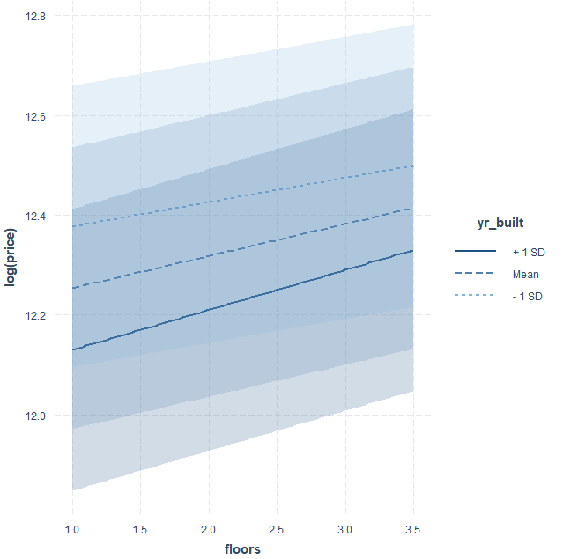
Interactions: The interaction term (floors:yr_built)
Notes:
Manmeet

Slide 18
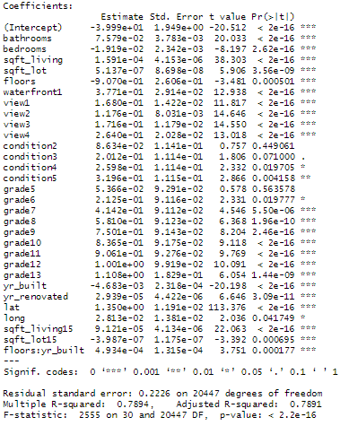
Interaction
Output
Notes:
Manmeet

Slide 19
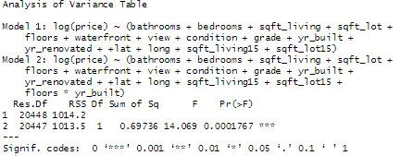
Interactions
Partial F-Test Result: The interaction term (floors:yr_built)
H0 : Model without interaction is better(interaction terms are not significant to the model)
Ha : Model with interaction is better(interaction terms are significant to the model)
P-value < 0.05
Fail to accept H0
Notes:
Manmeet

Slide 20
Comparison between Model with interaction and model without interaction
Model | RMSE | MAPE | R2adj
Non-Interaction | 127,333.8 | 0.1789524 | 0.7889
Interaction | 127,528.5 | 0.1787059 | 0.7890
Notes:
Manmeet

Slide 21
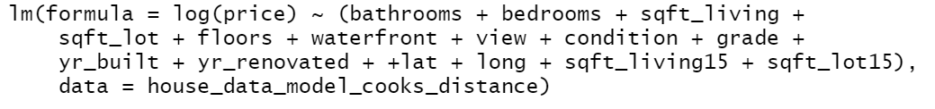
Final Model
MAPE | 17.82%
MAE | 91175.23
MSE | 17061117974
RMSE | 130618.2
Notes:
Manmeet

Slide 22
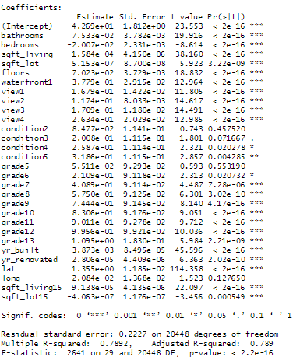
Final Output
Notes:
Manmeet

Slide 23
Thank You

Slide 24
References
https://en.wikipedia.org/wiki/King_County,_Washington

